Slide 1
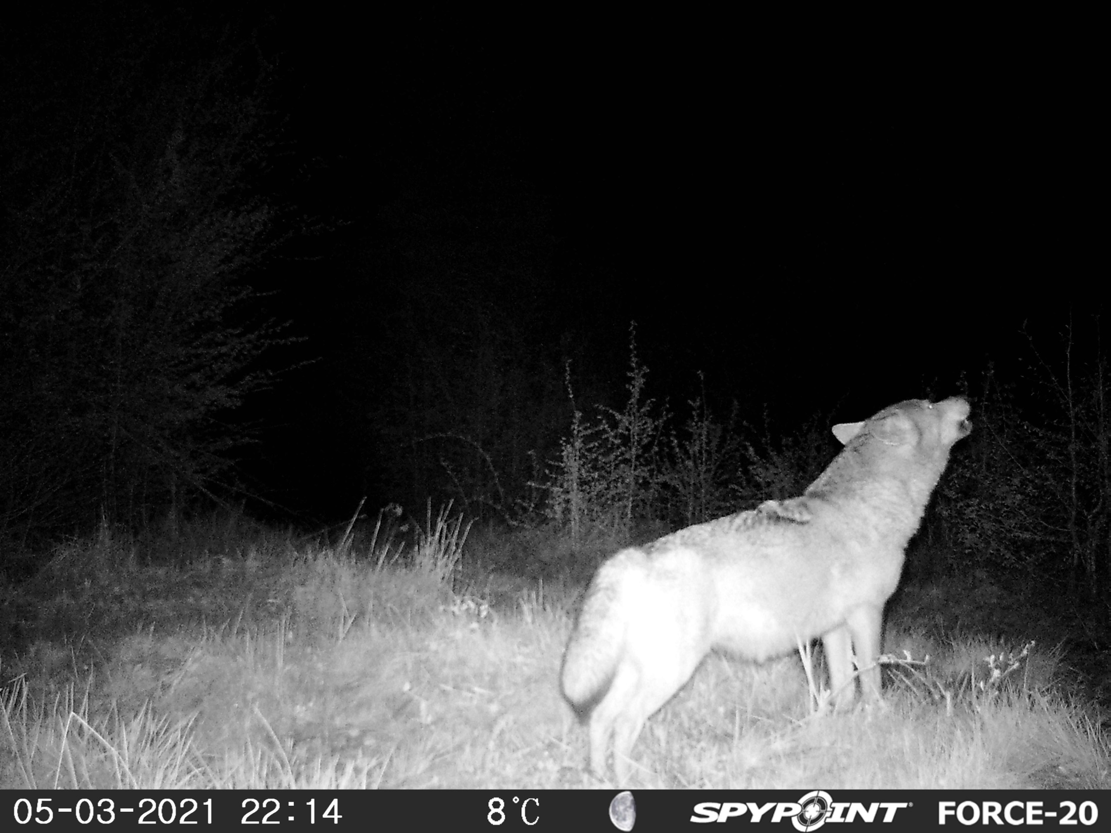
Occupancy modeling
占用率建模

Slide 2
Why use occupancy modeling for population dynamics?
为什么要用占用模型进行种群动态分析？
Occupancy modeling: a tool to estimate true populations
Can use occupancy (presence/absence) data to look at population trends
The ability to estimate populations often confounded by the inability to accurately count species
  Occupancy modeling can be used to get more accurate estimates
Able to use occupancy modeling to look at species distributions
  Multiple season/year data can show how these distributions are changing over time
  占用率模型：估算真实种群的工具
  可利用占用率（存在/缺席）数据来研究种群趋势
  由于无法准确计数物种，估计物种数量的能力常常受到限制
  占用率模型可用于获得更准确的估计值
  能够使用占用率模型来观察物种分布情况
  多个季节/年份的数据可以展示这些分布随时间的变化

Slide 3
Parameters of Interest: Occupancy
相关参数：占用
The proportion of area, patches or sample units that is occupied
  ie. a species presence
Ψ (psi): probability that a randomly selected site or sampling unit in an area of interest is occupied by a species
被占用的区域、地块或样本单位的比例
  即某物种存在
Ψ（psi）：在相关研究区域内随机选择的样地或样本单元被某一物种占用的概率
Notes:
What really is occupancy? Whether or not a species is present or absent in a space….
where x = number of occupied sites and s = total number of sites)
BUT, because not all individuals are detected, the x value is not typically known and therefore need to estimate detection probability to estimate occupancy

Slide 4
Parameters of Interest: Detection
相关参数：检测
Detection Probability (Pj): the probability of detecting the species during the j^{th} survey, given it is present
  considered an a priori expectation that a particular site will be occupied by the species as determined by some underlying process
Proportion: realization of that process
The distinction becomes important when a large portion of the population of interest is sampled
检测概率 (Pj)：在第 j 次调查中检测到某物种的概率，前提是该物种存在
  这被认为是一种先验预期，即特定地点将被某物种占用，这是由某些潜在过程决定的
比例：是该过程的实现
当对大部分相关种群进行采样时，这种区分就变得非常重要了
Notes:
What process?

Slide 5
Why use occupancy?
为什么要使用占用率模型？
Presence/absence data is easier to sample and collect than abundance, especially for rare species
  Requires less effort and is less expensive to collect
Can be used to study both single species and multiple species
For monitoring it can used as a metric reflecting the current state of the population
使用存在/缺席数据比使用丰度数据更容易进行采样和收集，尤其对于稀有物种而言
  收集占用率数据所需的工作量较小，成本较低
可用于研究单一物种和多个物种
在监测中，占有率模型可以作为反映种群当前状态的指标

Slide 6
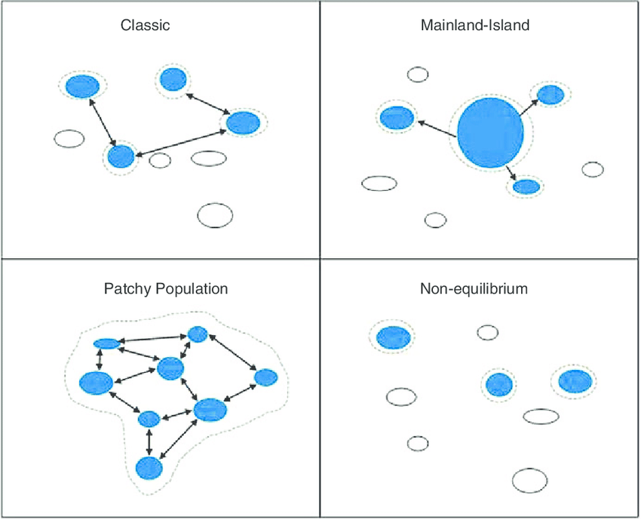
Occupancy can be used for
占用率可用于:
Metapopulation dynamics (patch occupancy models)
Observed colonization and extinction
Distribution and range
Animal invasions
Disease dynamics
Habitat relationships
Extensive monitoring programs: 'trends' or changes in occupancy over time
种群动态（地块占用模型）
观察到的迁入和灭绝
分布和范围
动物入侵
疾病动态
栖息地关系
广泛的监测计划：通过观察占用率随时间的变化，了解物种的趋势和变化

Slide 7
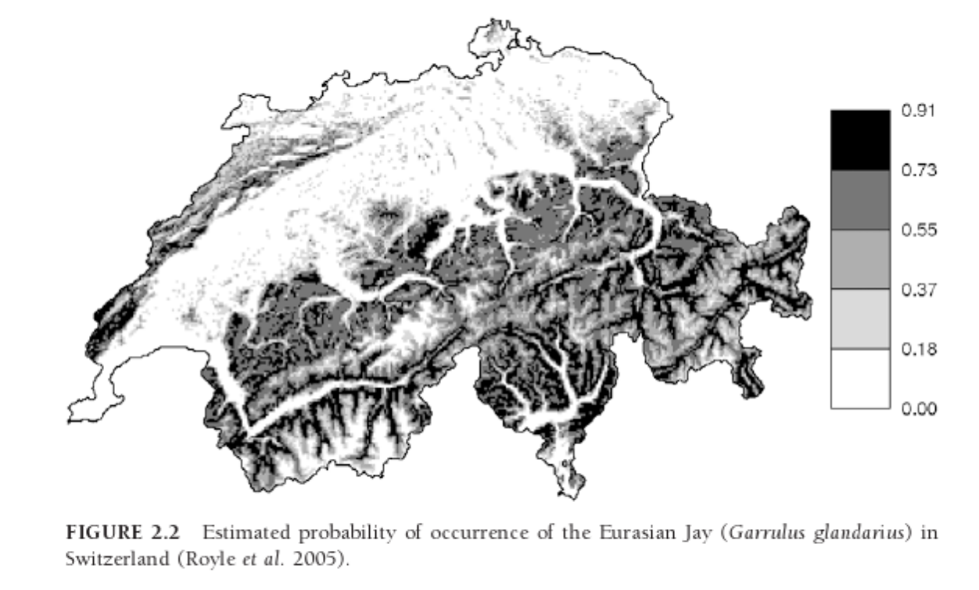
Geographic Range
地理范围
Area of occurrence: the set of grid cells that contain at least one individual when a grid is superimposed on the area containing all individuals of a species (but may contain cells with no individuals)
占用率区域：网格叠加在包含某物种所有个体的区域上时，至少包含一个个体的网格单元的集合（这些网格单元可能包含没有个体的部分）

Slide 8
Habitat Relationships
栖息地关系
Use presence/absence data to determine habitat variables that describe sites occupied by species (or not)
Use habitat variables to which a species responds and then develop habitat models or predict abundance/occupancy
Majority of habitat studies based on occupancy have been directed at conservation and management
False-absences need to be considered
使用存在/缺席数据来确定描述被物种占用（或未占用）的栖息地变量
利用物种响应的栖息地变量，然后开发栖息地模型或预测丰度/占用率
大多数基于占用率的栖息地研究都是为了保护和管理而进行的
需要考虑假缺席问题

Slide 9
Occupancy data
占用率数据
Presence-absence data: estimation of occupancy rates and associated dynamics that are fundamental for habitat model and metapopulation studies
Whether a “patch” (or site) is occupied by one or more individuals of a population or species
存在—缺席数据：估计占用率和相关动态，这是栖息模型和元种群研究的基础
一个“地块”（或样地）是否被一个种群或物种的一个或多个个体所占用

Slide 10
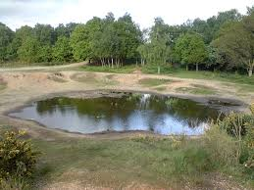
Occupancy data
占用率数据
Unit of interest: the extent of occurrence or area of occupancy
Example: for pond dwelling amphibians, the pond is the unit of interest
研究对象单元：物种出现的范围或占用的面积
例如：对于栖息在池塘中的两栖动物，池塘就是研究对象单元

Slide 11
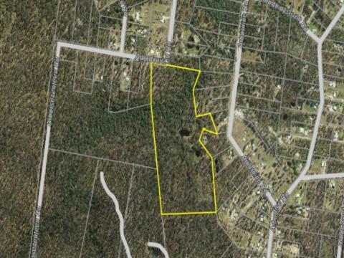
Occupancy data
占用率数据
Unit of interest: the extent of occurrence or area of occupancy
Example: for a terrestrial animal being studied units may be defined as 1,000 hectare blocks within a national park
研究对象单元：物种出现的范围或占用的面积
例如：对于正在研究的陆地动物，研究对象单元可以定义为国家公园内的1,000公顷地块
Notes:
line that encloses an area containing all of the individuals of the species-this area should include all of the sites occupied by the species

Slide 12
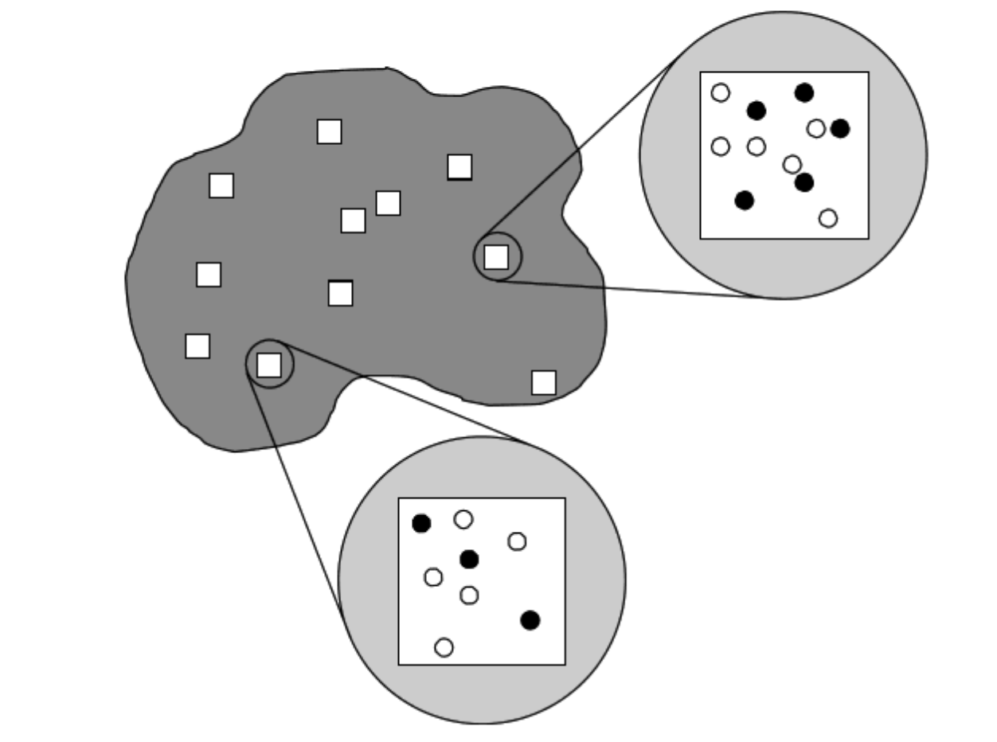
2 critical factors when sampling animal populations
动物种群采样时的 2 个关键因素:
Spatial variation
  Investigators select a sample of locations to survey
Detectability
  Even in surveyed areas, animals and whole species can go undetected
  空间变化
  调查人员选择一些采样地点进行调查
可检测性
  即使在已经进行了调查的区域，动物和整个物种也可能未被检测到

Slide 13
Occupancy data: Non-detection
占用率数据：未检测到
Non-detection does not equate to species absence
Bias: sites may be visited but no animals detected therefore producing false negatives
  “False-absence”
Failure to account for imperfect detectability will result in:
  Underestimates of site occupancy
  Biased estimates of local colonization and extinction probabilities and turnover rates
Therefore need to incorporate detection as a parameter into occupancy models
未检测到并不等于没有该物种
偏差：可能该物种考察了样地，但没有被检测到，因此产生假阴性结果
  “假缺席”
如果不考虑不完美的可检测性，将导致以下问题：
  低估了地点的占用率
  局部定居和灭绝概率以及物种更替率的偏差估计
因此，需要将检测作为占用率模型的一个参数来考虑

Slide 14
Occupancy Sampling Protocol
占有率采样流程
No restrictions on sampling approaches
  Can include: visual observations of animals, captures of animals in traps or mist nets, observations of animal tracks, detection of animal vocalizations, camera traps
Survey produces a list of surveyed sites that are:
  “Occupied” (species detected)
  “Unoccupied” (species not detected)
Counts of occupied sites are used to compute the proportion of occupied sites among all sites visited
  Estimate of occupancy
采样方法不受限制
  可包括：对动物的视觉观察、捕获陷阱或捕鸟网中的动物、动物足迹的观察、动物声音的检测、相机陷阱
调查会产生一份调查样地清单
  “被占用”（测到的物种）
  “未被占用”（未检测到物种）
占用样地的计数用于计算所有被考察样地中占用样地的比例，从而估计占用率
  占用率估计

Slide 15
Data Collection
数据收集
Data is collected by visiting a number of sites and recording whether individuals of interest are present (recorded as 1) or not present (0)
Important to repeat surveys over a short time frame (no changes in the state of a given site are allowed)
Occupancy probability: calculated as the proportion of sites that are occupied
Extinction probability: calculated as the proportion of occupied sites at time t, not occupied at time t+1.
Results can be confounded by detection error
  Recorded ‘absence’ may be a ‘non-detection’ of available individuals and not true absence
收集数据的方法是通过考察一些样地，记录研究相关的个体是否存在（存在记录为 1）或不存在（不存在记录为0）。
必须在短时间内进行重复调查（不允许改变特定地点的状态）
占用概率：按占用样地的比例计算
灭绝概率：按 t 时间已被占据、t+1 时间未被占据的地点比例计算。
检测误差可能会干扰检测结果
  记录 为“缺席”的数据可能是相关个体“未被检测到”，而不是真正的缺席

Slide 16
Data Collection: Detection Error
数据收集：检测误差
Detection probability (p):
  Factors other than abundance may influence detection probability
  Individual animals may be more visible or detectable in one habitat than another; weather patterns may influence detection, etc.
  Potential for misleading inference about true relationship between occupancy and habitat
If detection probability can be calculated, then unbiased estimators of occupancy, extinction and colonization can be derived
检测概率 (p)：
  丰度以外的因素也可能影响检测概率
  个体动物在某些栖息地中可能更容易被看到或检测到；天气模式可能影响检测等。
  存在误导性的推断，可能会影响占用率与栖息地之间的真实关系
如果可以计算检测概率，那么就可以得出关于占有率、灭绝和迁入的无偏估计值

Slide 17
Data Collection: Detection Error
数据收集：检测误差
Detection Error Solutions:
Dealing with false-absences by visiting sites multiple times to avoid missing a species
Statistically address the issue by incorporating detection parameters into occupancy models
Best Case Scenario: incorporate BOTH collection of additional information (visiting site multiple times) into sampling protocol and utilizing models that incorporate detection probabilities
检测误差的解决方案：
通过多次考察样地来避免遗漏物种，从而解决假缺席的问题
通过将检测参数纳入占用率模型，从统计学角度解决这一问题
最佳方案：将收集额外信息（多次考察样地）和利用包含检测概率的模型纳入采样流程中

Slide 18
The Issue with Detection and Occupancy Probability
检测和占用率概率的问题
Wildlife species are rarely detected with 100% accuracy
The issue: the measure of occupancy (presence/absence at a set of sites) is confounded with the detectability of the species
Detectability (p) can vary among study sites
  Can be related to site and survey level parameters: temperature, precipitation
Due to variation in detectability presence/absence data cannot be simply analyzed
Inferences of site characteristics on occupancy will be hard to discern reliably
野生动物物种的检测很少能达到 100% 的准确率
问题：占用率（在一组地点的存在/缺席）的衡量标准与物种的检测率相混淆
不同研究地点的检测概率（p）可能不同
  可能与样地和调查水平的参数相关，例如温度、降水量
由于检测性的差异，存在/缺席数据不能简单地进行分析
很难可靠地辨别样地特征对占用率的推断（很难准确地判断某个样地的特征与物种占有率之间的关联性）

Slide 19
Site occupancy: A solution
样地占用：一个解决方案
MacKenzie et al. 2002 (Ecology)
Key design issues: Replication
  Temporal replication: repeat visits to sample units
    Replicate visits occur within a relatively short period of time (e.g., a breeding season)
  Spatial replication: randomly selected ‘sites’ or sample units within area of interest
MacKenzie等人（2002年，生态学）提出的解决方案
关键设计问题：复制
  时间复制：重复考察样本单元
    在相对较短的时间内（如繁殖季节）重复考察样地
  空间复制：在相关区域内随机选择“样地”或样本单元

Slide 20
Basic Sampling Scheme:
Single Season
基本采样方案：
单季节
s sites are surveyed, each at k distinct sampling occasions.
Species is detected/not detected at each occasion.
对 s 个地点进行调查，每个地点进行 k 次不同的采样。
物种在每次采样时被检测到/未被检测到。

Slide 21
Necessary information: Detection histories
必要信息：检测历史
Detection history: Record for each visited site or sample unit
  1 denotes detection
  0 denotes non-detection
Example detection history: h_{i} = 1 0 0 1
  Denotes 4 visits to the site
  Target species detected during visits 1 and 4
  0 does not necessarily mean the species was absent
    Not detected, but could be there!
    检测历史：记录每个样地或采样单元
  1 表示检测到物种
  0 表示未检测到物种
    检测历史示例： h_{i} = 1 0 0 1
  表示 4 次考察样地
  第 1 次和第 4 次考察中发现的目标物种
  0 不一定意味着该物种不存在
    没有被检测到，但可能存在！

Slide 22
Occupancy protocol
占用率流程
Several sampling units surveyed
对多个采样单元进行调查。

Slide 23
Occupancy protocol
占用率流程
1
0
Several sampling units surveyed
对多个采样单元进行调查
0
Collection of detection/non-detection
收集检测到/未检测到的数据
1
1
0

Slide 24
Occupancy protocol
占用率流程
1001
0011
Several sampling units surveyed
对多个采样单元进行调查
0000
Collection of detection/non-detection
收集检测到/未检测到的数据
1011
1111
Replicate surveys in each unit
在每个单元中进行重复调查
0000

Slide 25
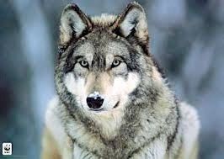
True or false absence?
真缺席还是假缺席？
1001
0011
0000
1011
1111
reality
现实

Slide 26
True or false absence?
真缺席还是假缺席？
0011
1001
0011
1001
0000
0000
1011
1011
1111
1111
0000
reality
现实
observation
观测

Slide 27
True or false absence?
真缺席还是假缺席？
1001
0011
1001
0011
0000
0000
1011
1011
1111
0000
1111
reality
现实
observation
观测

Slide 28
True or false absence?
真缺席还是假缺席？
1001
0011
1001
0011
0000
?
1011
1011
1111
?
1111
reality
现实
observation
观测

Slide 29
Data structure
Sampling units = sites
We do repeated observations at each site
采样单元 = 样地
我们在每个样地进行重复观察
 | visit 1 | visit 2 | visit 3
site 1 | 1 | 0 | 1
site 2 | 0 | 1 | 1
… | … | … | …
site 3 | 0 | 0 | 0

Slide 30
Detection, detection, detection
检测、检测、检测
Example detection history: h_{i} = 0 0 0 0
Is this site truly unoccupied?
It depends on the probability of detection (p)
检测历史示例：h_{i} = 0 0 0 0
这块样地真的未被占用吗？
这取决于检测概率 (p)
Direct relation between detectability and number of visits
Probability of NOT seeing the species after N visits
α = (1 – p) ^ N
Minimum number of visits before concluding the site is unoccupied at a confidence level α = 0.05
Nmin = log(0.05) / log(1 – p)
可检测性与考察次数之间的直接关系
N 次考察后未看到该物种的概率
α = (1 - p) ^ N
在置信度 α = 0.05 下，我们需要进行的最小考察次数才能得出该地点的确是未被占用的
Nmin = log(0.05) / log(1 - p)

Slide 31
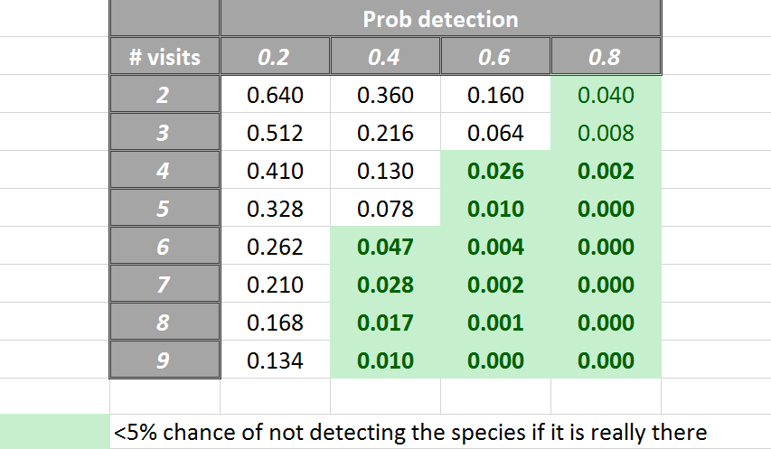
Necessary information: Detection histories
必要信息：检测历史
Probability of NOT seeing the species after N visits
N 次访问后未看到该物种的概率
α = (1 – p) ^ N
如果该物种真的存在，不被发现的几率<5%

Slide 32
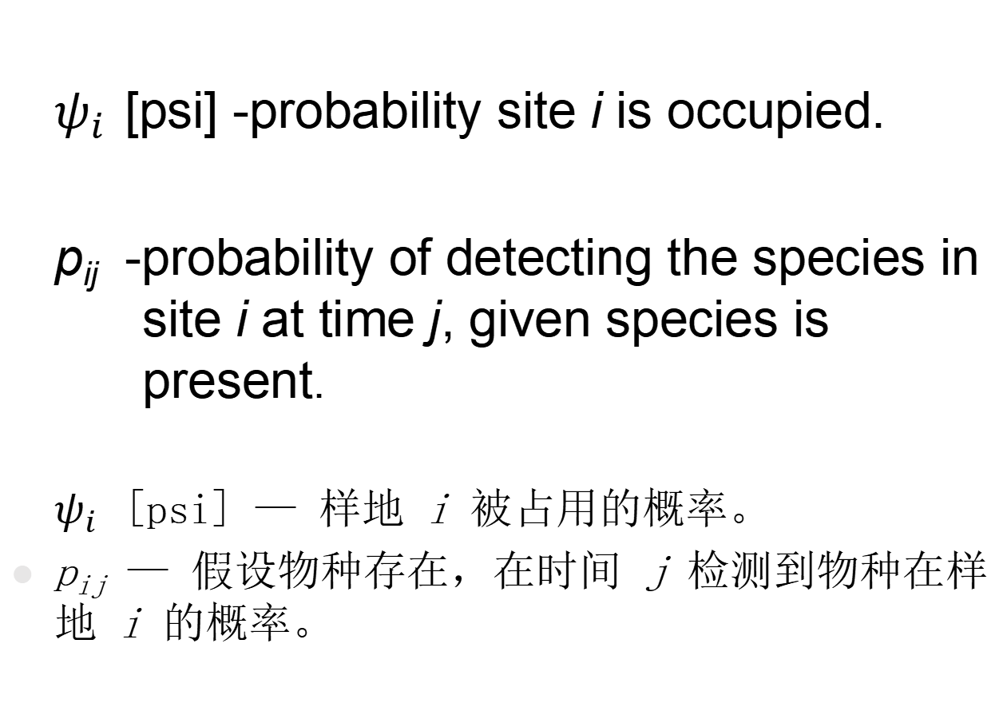
Model Parameters: Single-Season Models
模型参数：单季节模型
$ψ_{i}$ [psi] -probability site i is occupied.
p_{ij} -probability of detecting the species in site i at time j, given species is present.
$ψ_{i}$ [psi] — 样地 i 被占用的概率。
p_{ij} — 假设物种存在，在时间 j 检测到物种在样地 i 的概率。

Slide 33
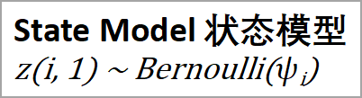
Hierarchical Statistical Model – 2 Processes
分层统计模型 - 2 个过程
State Model 状态模型
z(i, 1) ~ Bernoulli($ψ$_{i})
1001
0011
1001
0011
0000
?
1011
1011
1111
?
1111
reality
现实
observation
观测

Slide 34
Hierarchical Statistical Model – 2 Processes
分层统计模型 - 2 个过程
State Model 状态模型
z(i, 1) ~ Bernoulli($ψ$_{i})
Observation Model 观测模型
y_{i, t} ~ Bernoulli ( z_{i} * p_{i,t} )
1001
0011
1001
0011
0000
?
1011
1011
1111
?
1111
reality
现实
observation
观测

Slide 35
Model assumptions
模型假设
Sites are closed to changes in occupancy state between sampling occasions
No heterogeneity that cannot be explained by covariates
The detection process is independent at each site
  The farther apart, the better, but needs to be tailored to species ecology
在两次采样之间，样地的占用状态不会发生变化
没有协变量无法解释的异质性（即所有的变异/异质性都可以通过已知的因素来解释，而不需要考虑其他未知或未测量的因素）
每个样地的检测过程都是独立的
  样地距离越远越好，但需要根据物种生态特点进行调整

Slide 36
Timing of repeated surveys
重复调查的时间安排
Usually conducted as multiple discrete visits (e.g., on different days)
Can also use multiple surveys within a single visit
  Multiple independent observers
  Potentially introduce heterogeneity into data
    Single visit to each site vs. multiple visits to each site
  Rotate observers amongst sites on each day
  order each site is sampled within a day
  通常进行多次不连续的考察（例如，在不同的日子里）
  也可以在单次访问中进行多次调查
  多个独立观察员
  可能会引入数据的异质性
    每个样地只进行一次考察 vs. 对每个样地进行多次考察
  观察员每天在不同地点轮流观察
  对每个样地在一天内的采样顺序进行排序

Slide 37
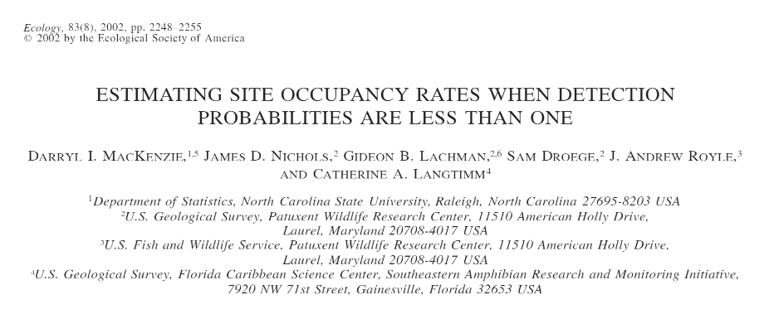
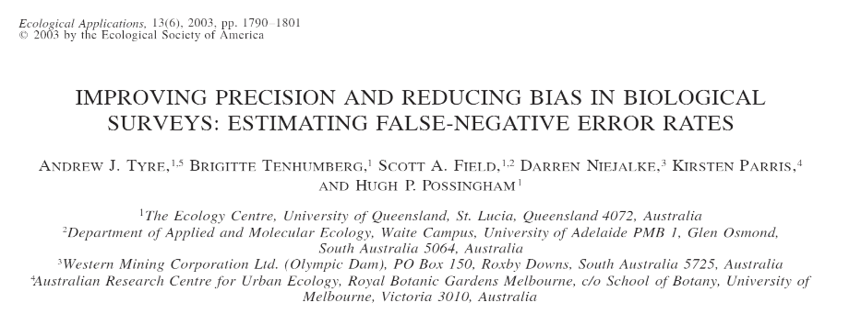

Slide 38
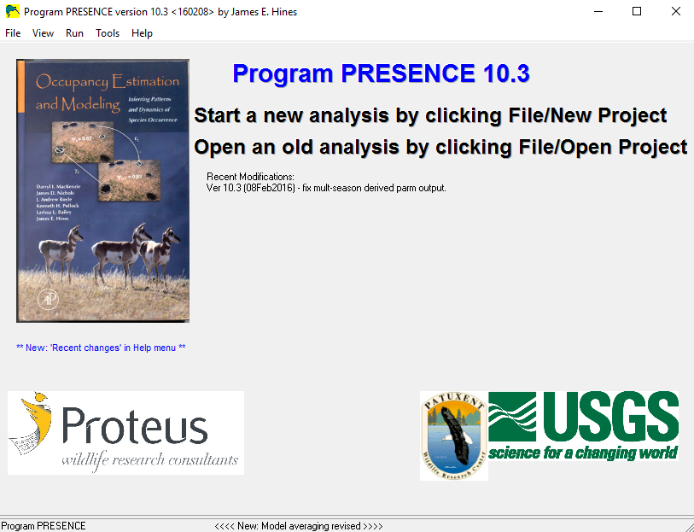
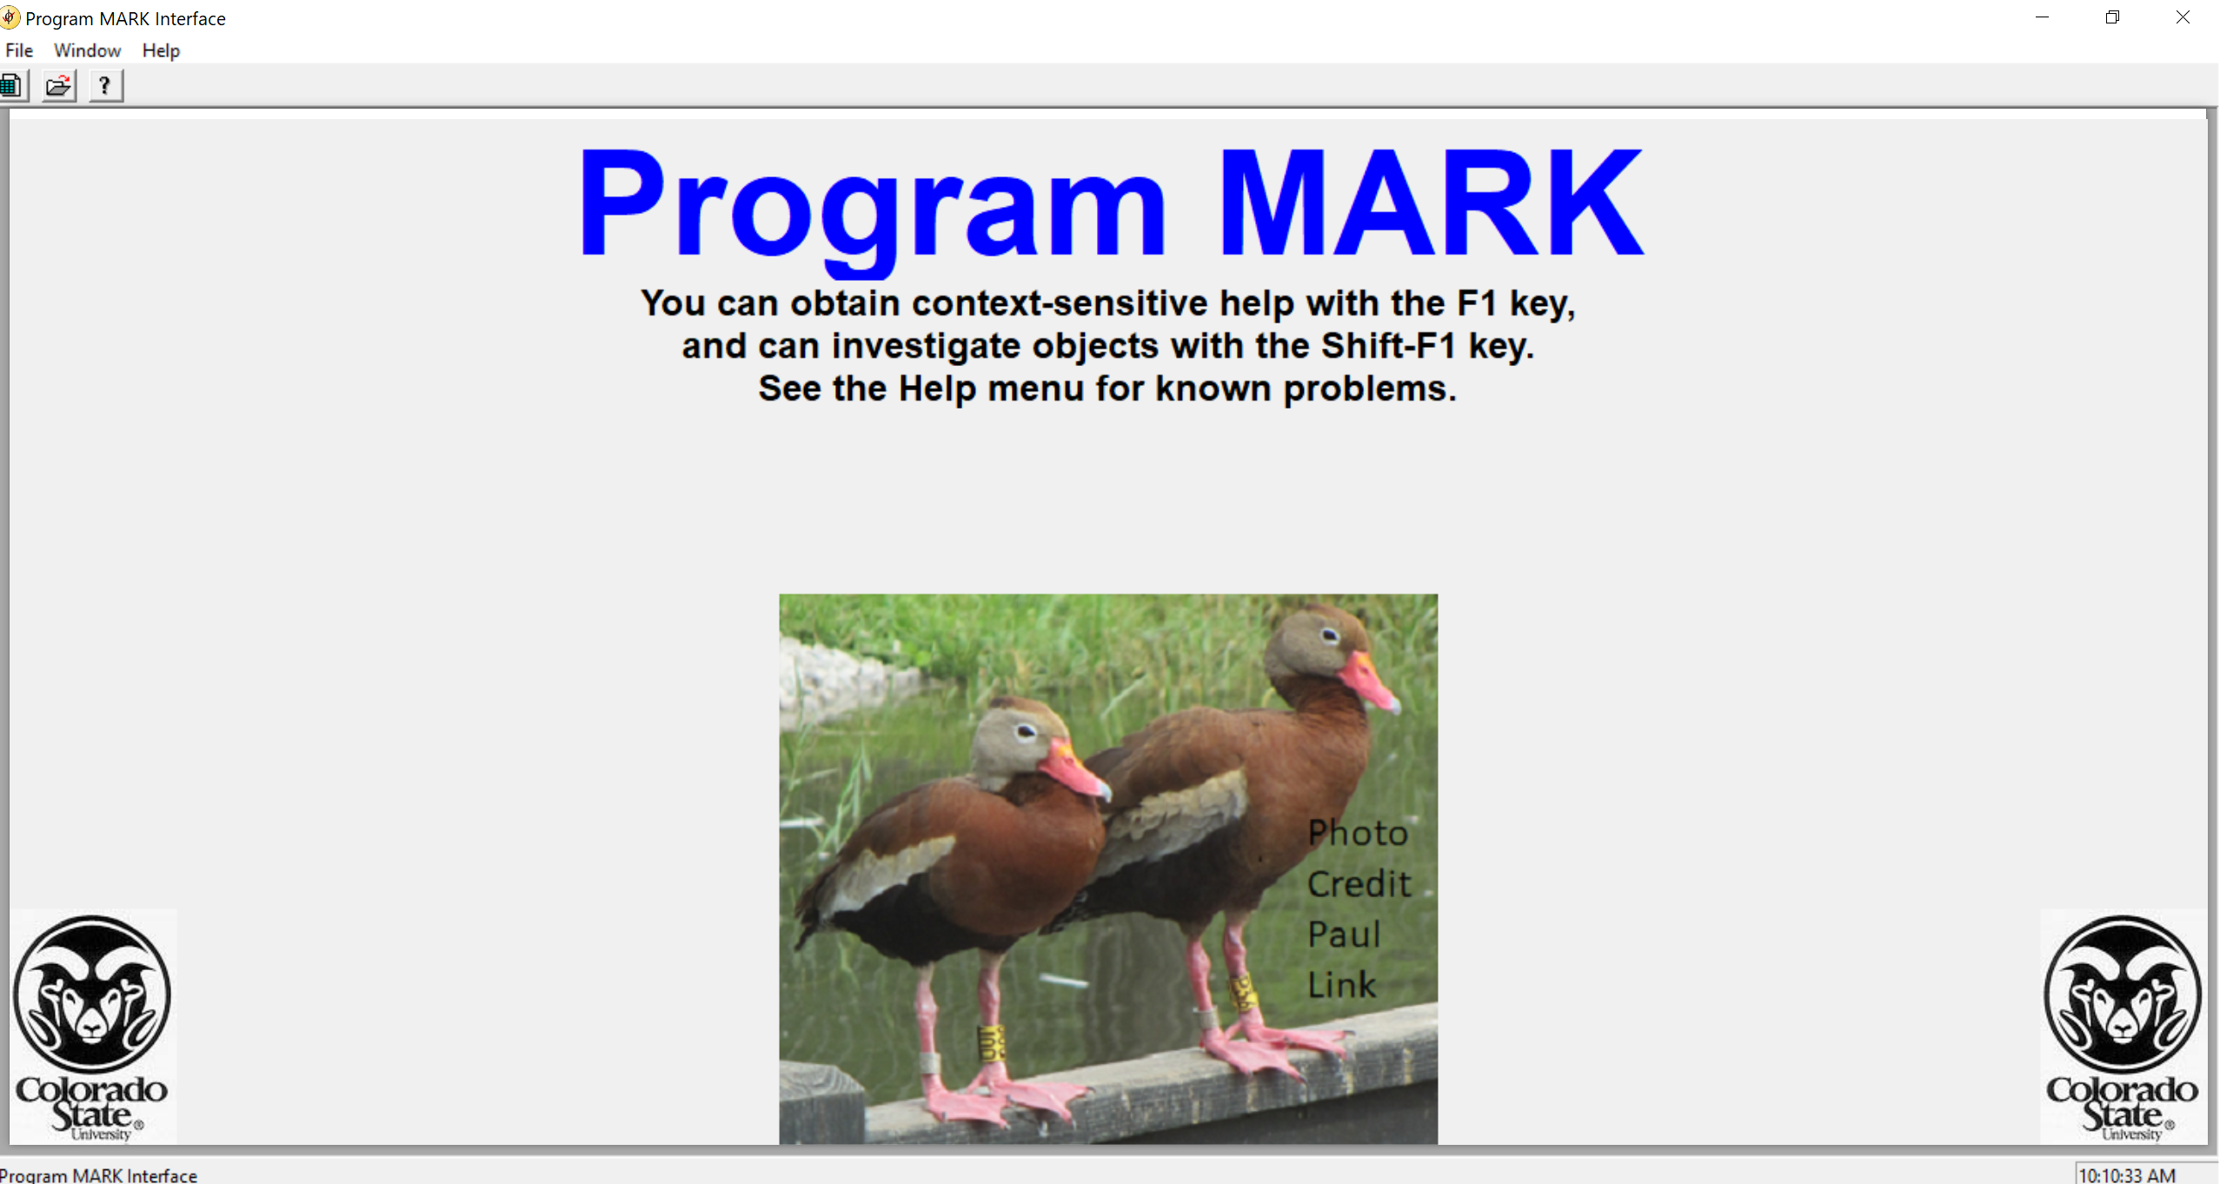
Complex occupancy models
implemented in programs PRESENCE and MARK
复杂的占用模型
在 PRESENCE 和 MARK 程序中执行
R packages: unmarked
spOccupancy (spatial occupancy models空间占用模型)
NIMBLE (Bayesian platform for model fitting模型拟合的贝叶斯平台)
ubms (includes random effects; Bayesian包括随机效应；贝叶斯法)
Notes:
Important tools for estimating N for mobile speices…. 1. Research CAPTURES, MARKS, and RELEASES as many individuals as possilbe, # Marked = M
2. Allows enough time for the marked individuals to mix intot the whole populaiton, then
3. Resampled the poupplation recording how many individuals are sampled (s) and how many of them possed the mark from the 1st visit and are therefore recaptured (r)

